Slide 1
What is the blockchain and how it relates to digital currency like bitcoin?

Slide 2
Blockchain
We can describe it as “ a constantly growing ledger which includes permanent records of all transactions securely and it is chronological and immutable”
A single source of truth which is permanent unchangeable and verifiable.
So you can not edit or remove any transaction made, they are available publicly on block explorers and can be looked up.
It is distributed : Thousand of copies of the blockchain are available in the network all over the world, so that makes it secure , because even if one instance of it get tampered and modified by hackers , that instance can be get rejected with all other valid copies. Plus its security comes from the highly advanced cryptography that is used to make the content of each block to be transferred securely. In fact its a series or a chain of blocks that have the reference of their previous blocks by holding their hash values, then even if one block gets hacked and modified not only that block get invalid , the whole next blocks get invalid as well so the hacker has to not only mind that block but also all the next block in less than 10 minute before any other new block adds to the chain by other miners. And in practice its not possible and even if done, as there are thousands of copies of the chain , the invalid chain will be rejected with other copies. This makes it secure as there is no single point of failure.

Slide 3
Bitcoin
A type of digital asset that can be bought sold transfer between parties securely over internet. So it can store values like gold, silver, or other type of investments.
Its a digital currency that used to buy services products etc or make payments electronically, different than other type of traditional currencies like euro dollar etc.
Different than other type of traditional currencies like Euro dollar etc
There’s no physical coins for bitcoins or paper bills. So when you buy or pay with bitcoin you don’t need to use any like banks or credit cards or third parties
Example: Sending pic is a copy of it not the original, so there needs to be bank middle ware to r sure there’s no double spend problem
How ?! It’s decentralized network called blockchain
It’s secure and used cryptography , Certify by math and cryptography

Slide 4
What are other cryptocurrencies?
Bitcoin
Litecoin
Z-Cash
Monero
Digital Cash
Etherium
Ripple

Slide 5
What is a digital token?
A digital token is another digital asset that can be used to represent anything. Some examples includes. Securities, loyalty, real world assets.
Audiocoin: Cryptographyfor music industry.
Golem: shared economy computing power
VeChain: Track supply chain on blockchain
Streemit: Rewards platform for content publisher
Cryptokitties: collecting breed digital cats
ICO , Initial coin offering : investment coin that helps startups to raise fund and receive ICO.
https://steemit.com/@streemit.online
https://sia.tech/
http://www.audiocoin.eu/
https://golem.network/
https://www.vechain.com/
https://steemit.com/
https://www.cryptokitties.co/

Slide 6
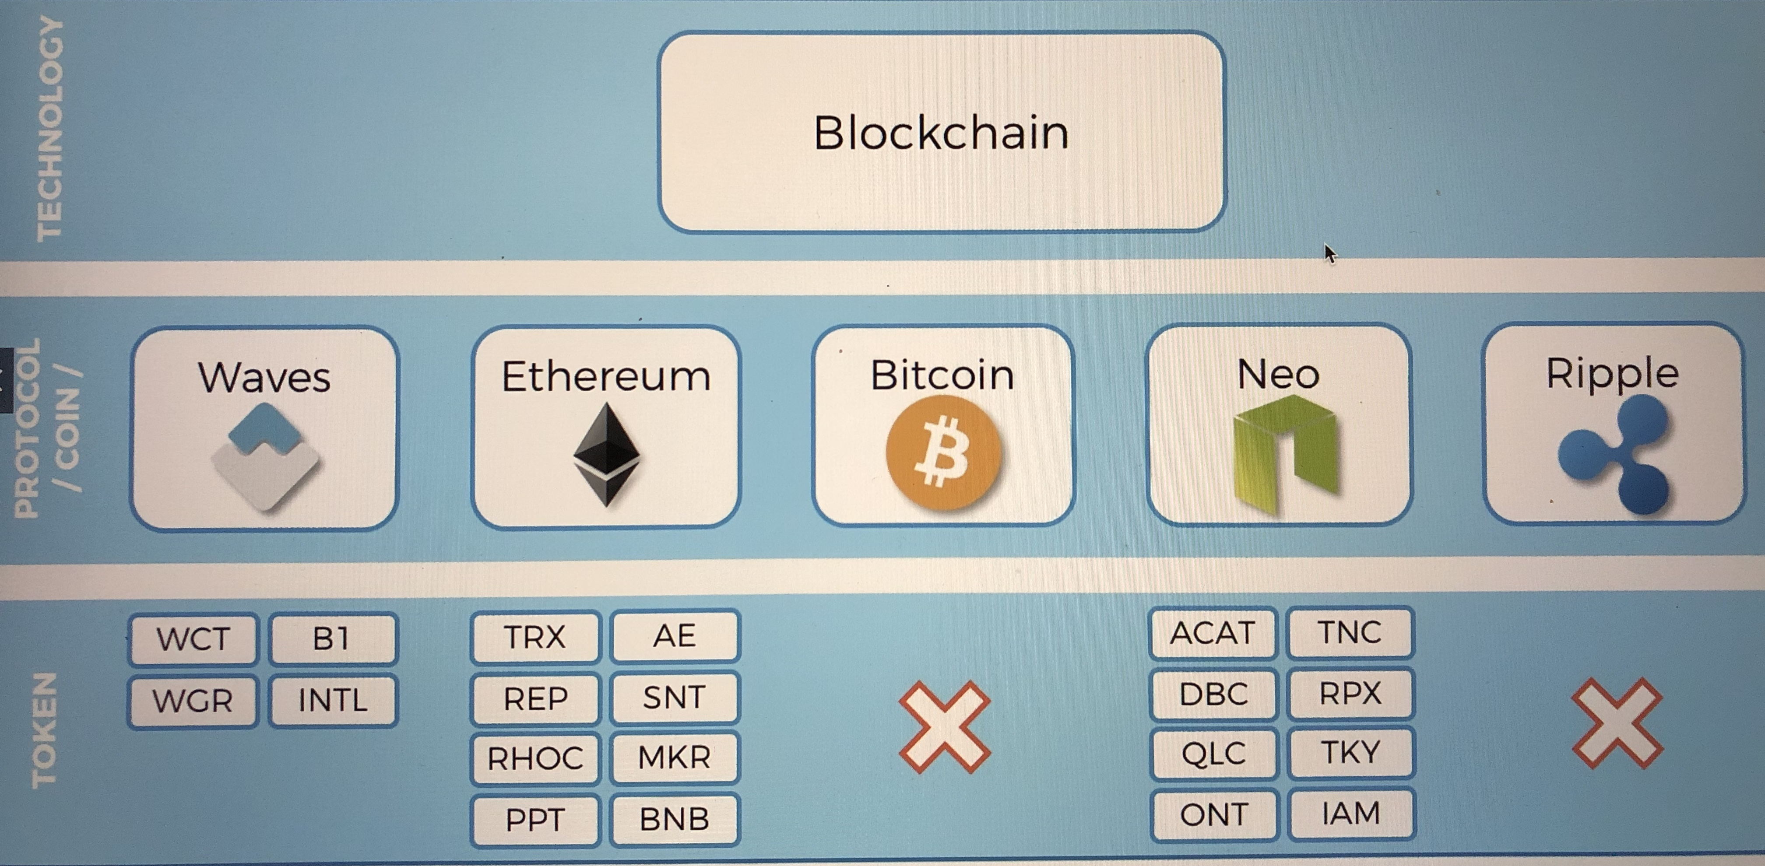

Slide 7
Who is a Miner?
Group of people on bitcoin network , they process and confirm transactions, they use very powerful computers specially designed to line bitcoin transactions
How by solving math problems and they rewarded in bitcoin.

Slide 8
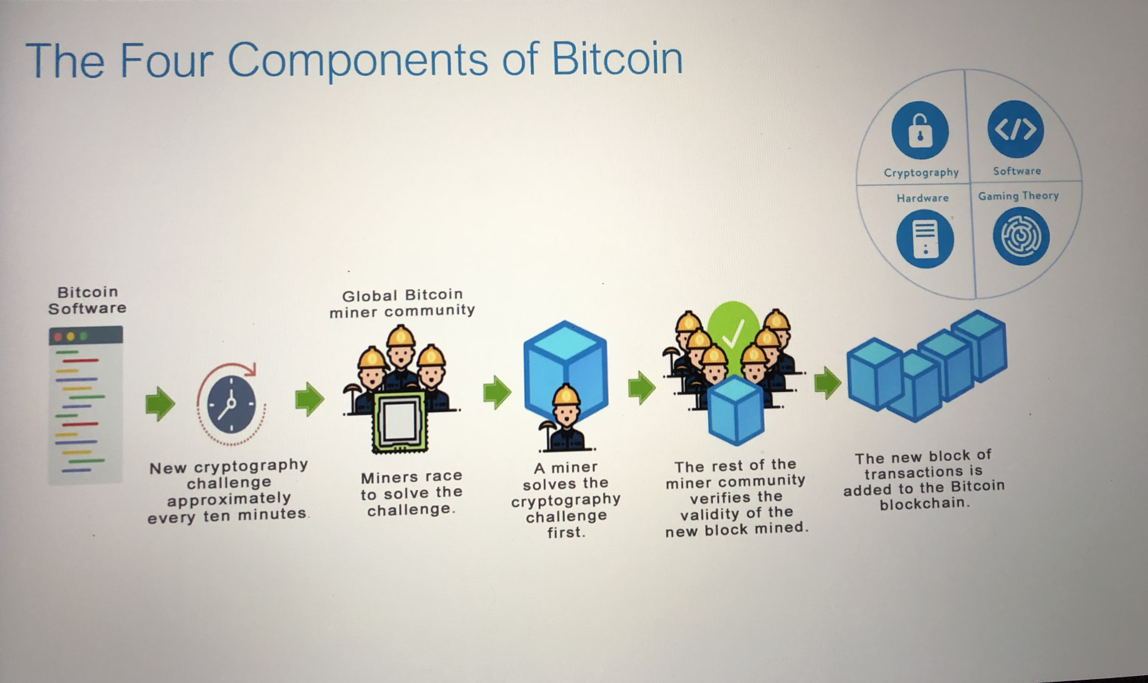

Slide 9
How it works?
It’s not like fiat currencies like dollar which are backed by countries governments. They are created by central backs , bitcoin. Is not.
The way bitcoin is created is by rewarding these miners for their work of math problems and cryptography.
Role of miner: build the blockchain of records that form the bitcoin ledger.
Block contains all transactions that happened, new block is created every ten minutes. And gets connected to the previous chain of block all back to the first block genesis block.
Cryptocurrency, use hash function generator
SHA256 Hash
Secure hash algorithm.
One way functions , no way to go back to original value . One way Finger print
Encryption is different two ways is.
If you break a block it will break all subsequent blocks, this is what guaranty the validity of bitcoin value

Slide 10
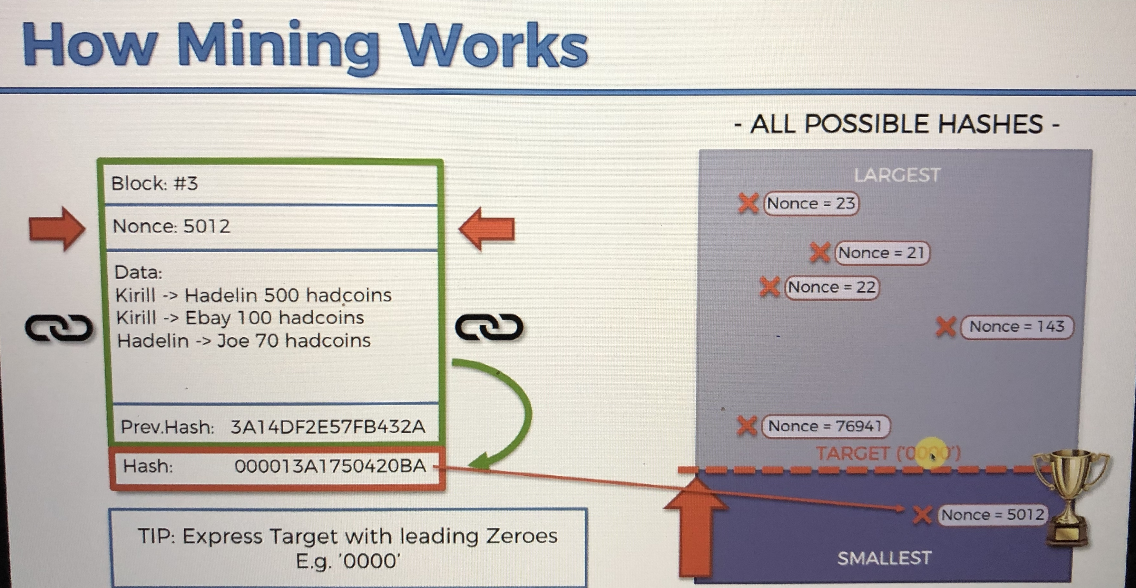

Slide 11
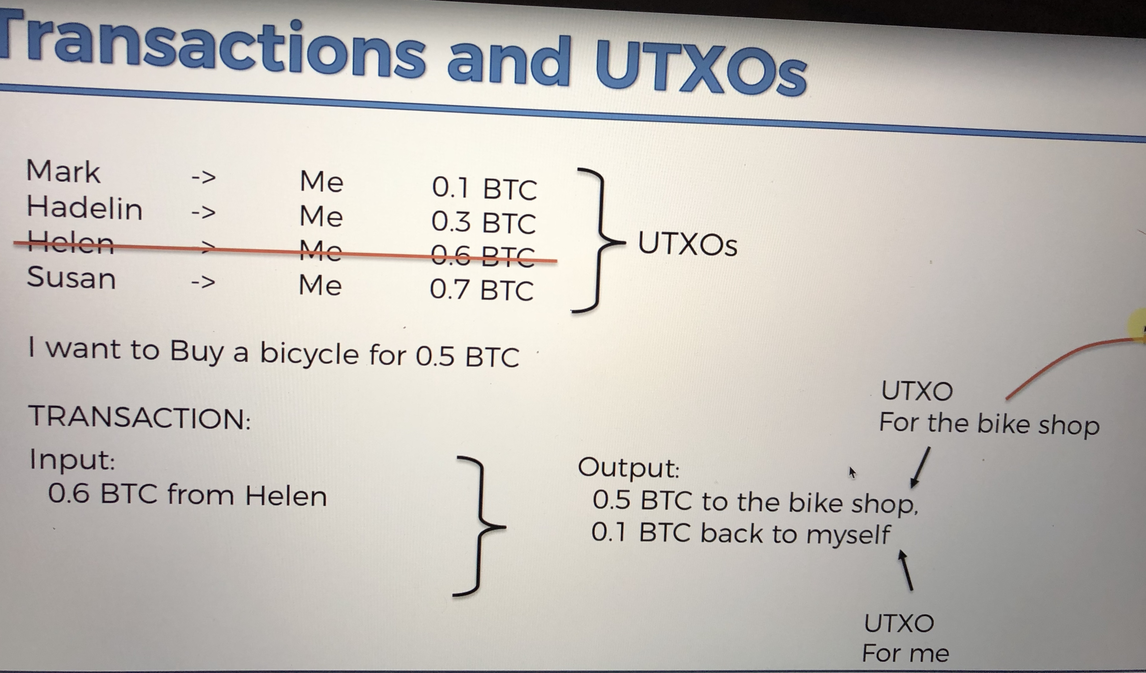

Slide 12
What is smart contract ?
Disintermediatiom and automation of workflows regarding to contracts which is self executing and immutable.
A smart contact is a computerized transaction protocol that executes the terms of a contract. Such as payment terms , confidentiality and enforcement. Minimizes the need for trusted middle parties like brokers. Lowering fraud costs, transaction costs and fees etc.

Slide 13
What DAO (Decenteralized Authonomous Organization)
Collection of smart contract, distributed networks on a Blockchain, Internet of things and artificial intelligence. Example of Ubers , eliminate or lesson the need of the middle runners , Human Resources etc.
Or DAC (Decenteralized Authonomous Corporation)

Slide 14
Five success cases :
1- Walmart: In partnership with IBM Tracking products across china , reduce the time to track food from days to minutes, Reducing costs
2- Real Estate: Australian bank ANZ, In partnership with IBM, Digitalized commercial property lease guarantees
3- Insurace: Maersk , In partnership with Microsoft , Shipping insurance, successful week proof of concept, Make auditing aspects of a shipping supply chain easier, Improve the tamper-resistance
4- Certificates of authenticity: DNV in partnership with Deloitte, Instant verification of certificates of authencities
5- Humanitarian Aid: United Nations world food program, Uses Etherium to aid Syrian refugees, 10000 syrian refugees living in the Azraq camp in Jordan

Slide 15
https://www.coindesk.com/walmart-blockchain-food-tracking-test-results-encouraging
https://bitsonline.com/banks-test-ibm-blockchain/
http://fortune.com/2017/09/05/maersk-blockchain-insurance/
https://www.dnvgl.com/assurance/certificates-in-the-blockchain.html
https://www.coindesk.com/united-nations-sends-aid-to-10000-syrian-refugees-using-ethereum-blockchain

Slide 16
What is the benefits of digital currencies?
reducing processing and workflow times of receiving sending paying money . With eliminating middle parties.
Reducing costs,
improve the tamper hack-resistance
Facilitate Humanitarian Aids by eliminating government roles and sanctions

Slide 17
What are the Limitations?
Early Stage
Lack of Awareness
Limited Available Technical Talent
It is Immutable so No reversal or modifications
Key Management
Scalability is still a challenge
Time to process and confirm transactions (10 min)

Slide 18
What are the misconceptions about bitcoin and blockchain?
Bitcoin is anonymous which is wrong
Bitcoin is used for money laundry or give more potential risks for frauds which is not True as it can be publicly traced.
Blockchain is a better Database
Blockchain is bitcoin or limited to digital currencies
You need to buy a full bitcoin , not true

Slide 19
What is Bitcoin Cash?
A new cryptocurrency developed from a hard fork in the bitcoin blockchain.
Increases block size to 8MB from the 1MB limit prior to the fork. Go to BitcoinCash.org for more info

Slide 20
When did it started? History of bitcoin
October 31 2008: Bitcoin Whitepaper
January 3, 2009: Genesis Block (The very first block of transactions that was published By the founder)
May 22, 2010: First Retail Purchase
2 pizzas for 10000 bitcoin (25USD)
So 1BTC was .0025 USD
November 28, 2013: 1BTC = $1000 USD
March 2nd 2017: 1BTC=1Oz of Gold

Slide 21
Future of Bitcoin Mining?
The question is
What happens when there is no more bitcoin left to mine?
There is a limit of 21 million bitcoin. The rate currently is 12.5 per block when miner is rewarded.
Why would minors continue to mine and process transactions if they won’t get rewarded anymore? Currency 16 million approximately bitcoin in circulation and estimate is that it will end at 2140 at the current trend.
There are transaction fees swell beside the coinbase transaction reward which is 12.5 .
The volume of the transaction goes higher that increases the fees rewarded to minors.
And also block size is also increasing. So the transaction fees would be enough.
When the founder of bitcoin first started , the reward was not 12.5 bitcoin it was 50 per block. Because there needed tone more bitcoins to start with in circulation but it gots in half every for years. (The halving) To control the trend. 50 * 10 min = 7200 new bitcoins per day

Slide 22
How to start with Bitcoin?
0- go to bitcoin.org ( an open source project and handled by global community)
1- setup your wallet (setup private and public keys)
(web mobile hardware (keep ur private keys offline)(cold wallet vs hot storage which is connected to Internet but does have risks of hackers) desktop ) you can have multiple wallet ( keep a certain amount only oh hot wallet)
2- send receive via your address which is hashed version of ur public key (can have multiple addresses) even one address per transaction to remain secure and difficult to track.
Alphabetical code
KUR code
BTC.com
https://btc.com/0000000000000000010be3f72df04f8359fda43d682157bde82cae0227596fff
SimpleBitcoin

Slide 23
Bitcoin Safetly:
Install key loggers malwares to track and hack:
If its on web or mobile wallet there is always this risk,
Not use public Wifi
Without VPNs
Use Cold wallet instead
Most important thing is to never share ur private key.
Remember bitcoin transactions are one way immutable not reversible. Then if your bitcoins are stolen there’s no way to have it back.
Only when blocks are mined the current transaction is confirmed and can be seen added or deducted from parties balance.
Use brain wallets and long passphrase for them .
Use paper wallets.
Use USB Drive
Use Hardware Wallet.

Slide 24
Converting Your bitcoins to Fiat Currency:
Not everybody accepts bitcoins
1- Use a cryptocurrency exchange: Coinbase.org Kraken.com Gemini.com Bitstamp.com
2- Bitcoin Debit Card: Coinbase.org Bitwala.com
3- Sell Them to someone else: Security risk involved
4- Local trading sites: LocalBitcoins.com
5- Bitcoin ATM or BTMs: Buy and sell ur bitcoins in ur local currency

Slide 25
Create A cryptocurrency
https://github.com/zyousefi105/portfolio/tree/master/cryptocurrency

Slide 26
Resources:
BlockchainInformer.com
https://www.blockchain.com/explorer
https://www.superdatascience.com/pages/blockchain
https://bitsonline.com/money-mining-bitcoins/
https://demoblockchain.org/hash
https://btc.com/
https://www.youtube.com/GeorgeLevy
https://bitcointalk.org/index.php?topic=137.0
https://www.youtube.com/watch?v=4afOBjpRcDw&feature=youtu.be
https://www.youtube.com/watch?v=6nPVoLhnndM&feature=youtu.be
https://coinbillboard.com/
https://bitsonline.com/cold-storage-bitcoin-hard-fork/
https://bitsonline.com/bitcoin-wallet-ready-hard-fork-august/
https://bitsonline.com/keep-bitcoins-safe-2fa/

